Slide 1
2D & 3D games using .NET and C# Game Development with Unity
By Monica B. Tvedt, 28.01.2019

Slide 2
Agenda
Download Unity while eating Pizza ( 14 min)
https://unity3d.com/get-unity/download (version: personal)
Create our first Unity Game
Setting up our new game
Moving our player object
Moving the camera
Setting up our Play Area
Collecting & Scoring
Build’n Ship our Awesome game

Slide 3
Setting up our new game (10 min)

Slide 4
Unity
Create new 3D Unity project “Roll a Ball”
Save our new Scene as “MiniGame” inside our “Scenes” folder
Create our playing ground by selecting “Game Object - 3D Object - Plane”
Reset our plane to Origin by selecting “Reset” in the Transform gear menu
Change the plane size to scale by 2
Create our player object “Player”, a Unity Sphere (Hierarchy tab -> Create menu select Sphere)
Lift the player object by half a unit in the Y axis.
Add some color to our Objects by creating materials
Select the directional light and in the transform component change the Transform Rotation on the Y axis to 60 for better lighting

Slide 5
Moving our player object (10 min)

Slide 6
Moving the player using input and physics forces
Create a folder “Scripts”
Select our Player object and select “add component -> physics -> rigid body”
Again Select our Player object and select “add component -> new script” (C#)
Move our script inside our Script-folder
Open our newly created script in Visual Studio

Slide 7
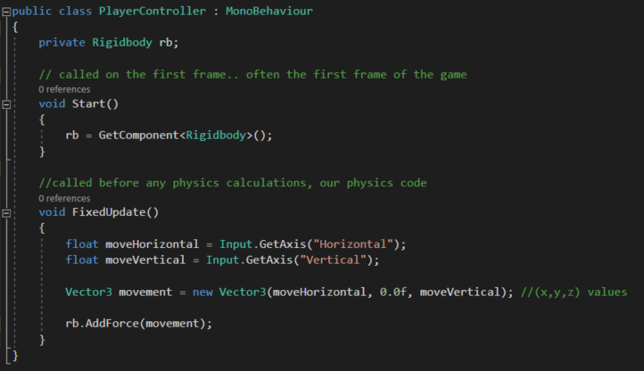
Our C# Script, using player input and Physics

Slide 8
Run our Game

Slide 9
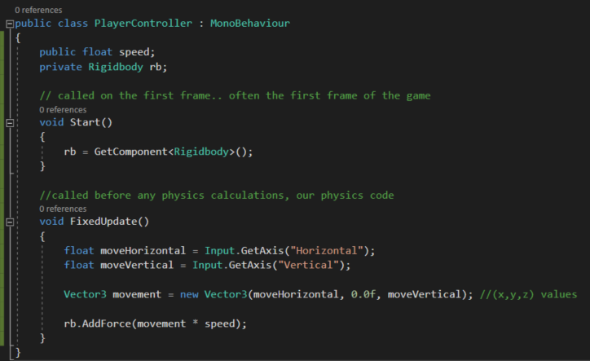
Public variable == editable property in Unity

Slide 10
Set Speed to 10 & Run our Game

Slide 11
Moving the camera (6 min)

Slide 12
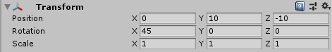
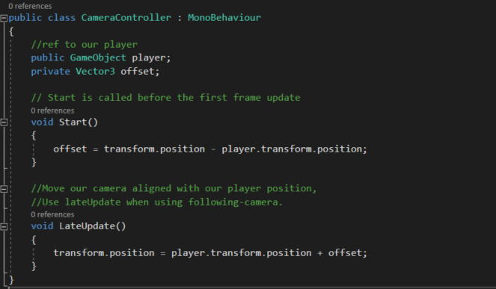
Camera Settings
Select our Main Camera object and enter the following Transform values:
Create a new belonging script “CameraController” in C# and drag the player-object to our new Player property in Unity.

Slide 13
Run our Game

Slide 14
Setting up our Play Area (4 min)

Slide 15
Our playing field
Create a new GameObject->Create Empty”, and name it “Walls”.
Reset the object origin (important!)
Create new GameObject -> 3D -> Cube, “West Wall” and reset origin.
Add our new Wall to our “Walls” object as a child
Change the Scale to X:0,5 Y:2, Z:20,5
Change the position to X:-10
Select our wall and click Edit->Duplicate “East Wall”, and X:10 as position
Duplicate our East Wall and call it “North Wall”, X:0 Y:10 as position, and Scale to X:20.5, Y:2, Z:0.5
Duplicate our North wall, call it “South Wall”, and Position Z: -10.

Slide 16
Run our Game

Slide 17
Collecting & Scoring
(20 min)

Slide 18
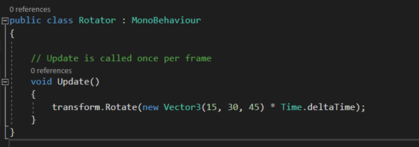
Collectable Objects
Create a new 3d Cube and name it “Pick up”
Reset Origin and lift it by half a unit
Scale it by 0.5 for X, Y and Z
Rotate it by 45 for X, Y and Z
Add a belonging script “Rotator” (C#)

Slide 19
Hide our Player & Run our Game

Slide 20
Collectable Objects as templates
Create a new folder “Prefabs” (templates)
Drag our Pick Up object to our new templates-folder
Create a new empty game object “Pick Ups” from our menu in our Hierarchy tab. Remember to reset to origin.
Drag our Pick Up object inside our new collectable object.
Select our Pick Up object, move to top-down-view, and set “Global”-mode.
Now Duplicate and create many such objects across our board
Change the color for our Pick Up objects

Slide 21
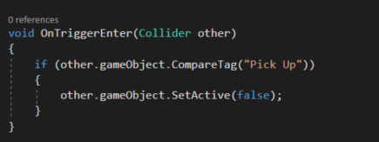
Collecting our objects
Open our PlayerController script and add the following:
Open our PreFab and enter the tag “Pick Up”
Make sure our Box Collider has “Is Trigger” selected
Add Rigid Body with “Is Kinematic” to our Prefab

Slide 22
Show our Player & Run our Game

Slide 23
Displaying our Score
Open our PlayerController script and add a private count. Initialize it to 0 and increment it when a collision occur in OnTriggerEnter.
Return to Unity and add a UI -> Text element.
Change the color and positioning to your likings.
Select our Player Object and drag our text element to our new Count Text property.
Do the same for our Win text. If our count is 12, then display a Win Message.

Slide 24
Open build, add our scene and play!

Slide 25


Slide 26
Thanks for watching
www.soprasteria.no

